Slide 1
Universidade Federal de Alagoas
Instituto de computação
Programa de Pós-Graduação em Informática - PPGI
Another aproach to code smell detection: assessing interpretability of decision tree-based detections
Master Student: Christiano Rossini Martins Costa
Advisor: Baldoino Fonseca dos Santos Neto

Slide 2
Study design
RQ1: How interpretable are machine learning techniques on detecting code smell?
Test perception of developer through visualization
RQ2: How confident is the developer to apply the suggested detections to his context?
RQ3:What’s the relationship between effectivity and interpretability?
how effectivity and interpretability are correlated

Slide 3
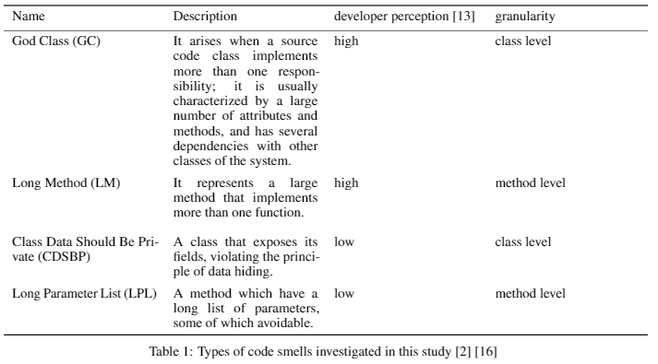
Study Context- choosing code smells types
based on perception of developer
how easy the developer are able to recognize different smell types?
number of Ocurrences in previous researches about code smell detection

Slide 4
Study context - softwares
Dataset of manually validated code smells, mined from 30 open source systems.
we chose 15 of these system to carry out later experiments
Other software couldn’t be included
Problems to find the correct version
Lack of oficial Github repository (old software)

Slide 5
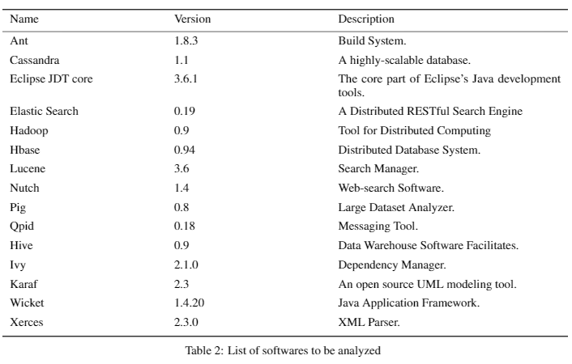
Study context - softwares

Slide 6
Study context – choosing software metrics
70 metrics available on SciTool Understand software
43 from clas level
27 from method level
Metric types (understand classification)
Complexity Metrics (e.g. McCabe Cyclomatic)
Volume - Size - Metrics (e.g Lines of Code)
Object Oriented (e.g. Coupling Between Object Classes)
Includes C.K. Metrics

Slide 7
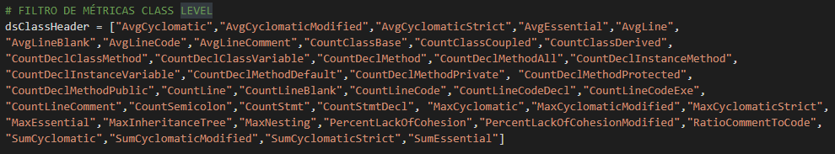
Study context – choosing software metrics

Slide 8
Study context – Building the datasets
4 datasets built, 1 for each code smell type
Independet variables: software metrics
Dependent variables: True or False, code smell or not
Step 1 – metrics extraction from classes, software by software
Aided by Understand tool
Step 2 – match all instances of classes/methods and their metrics with respectives code smell types. Match ID=class URI
Step 3 – deal with imbalanced dataset
Resampling technique — Undersample majority class: 1:3 ratio

Slide 9
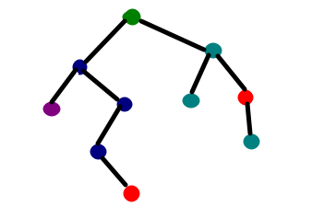
Manipulating DT models
Python’s Sklearn API
DT with an optimised version of the CART algorithm
Train the datasets with two decision tree setups
Setup 1:
param: entropy, max_depth=5
Setup 2:
Pre-processing: feature selection with Genetic Algorithm
param: entropy, max_depth=5
Setup 1
Without feature selection
Setup 2
With feature selection

Slide 10
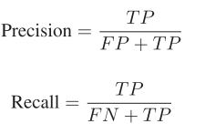
Manipulating DT models
Effectiveness Metrics
Precision
Recall
F-measure
Setup 1
Without feature selection
Setup 2
With feature selection

Slide 11
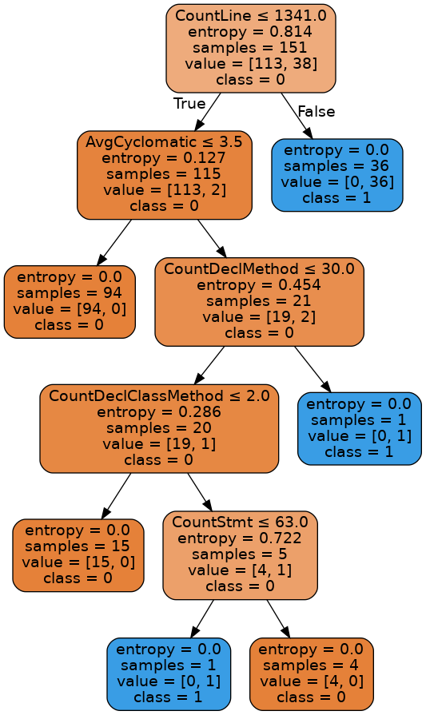
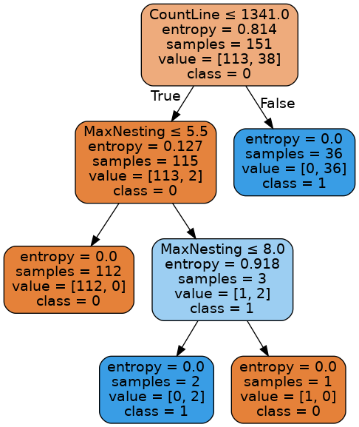
Manipulating DT models
GC visualization

Slide 12
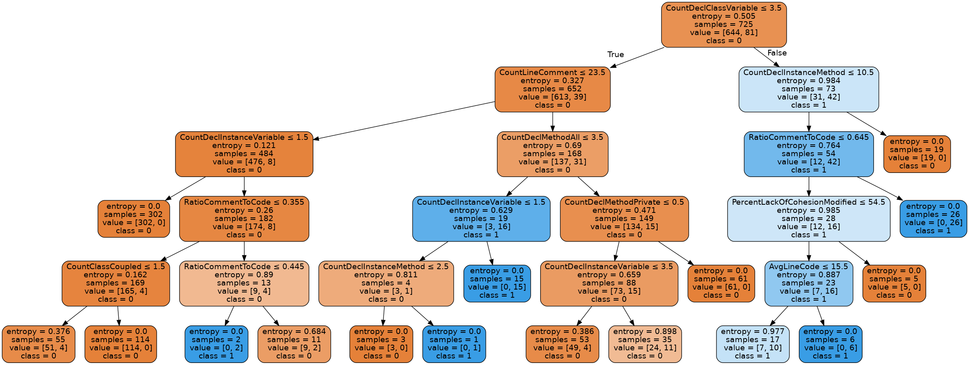
Manipulating DT models
CDSBP visualization

Slide 13
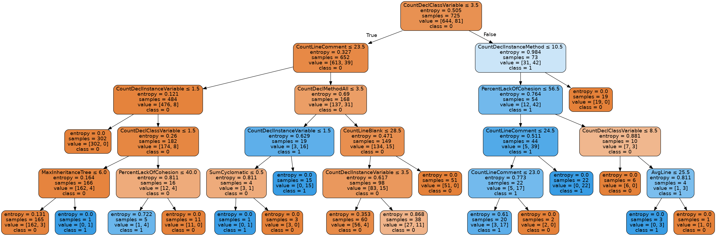
Manipulating DT models
CDSBP visualization with Feature Selection

Slide 14
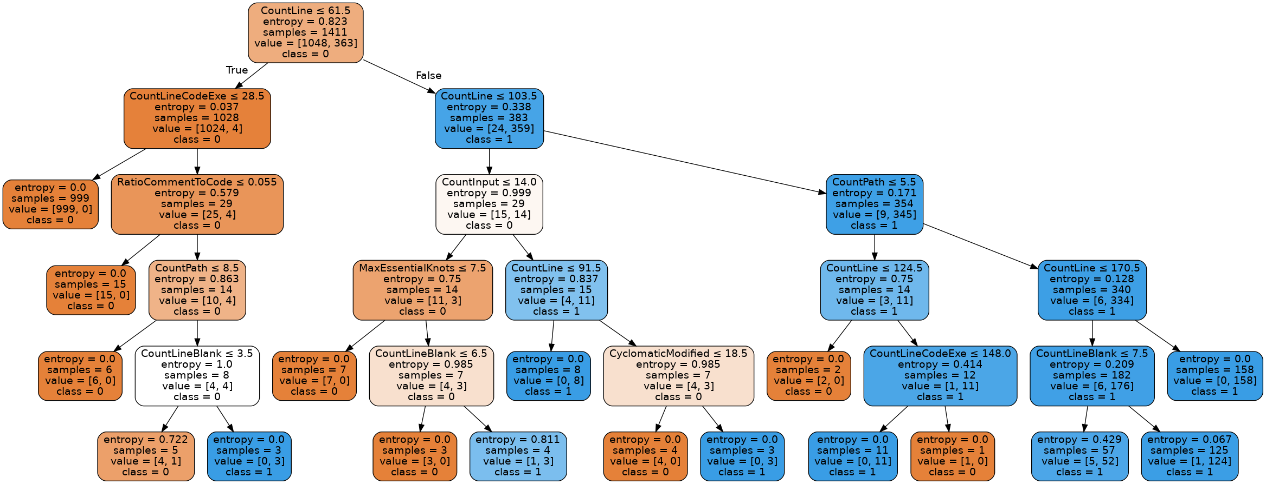
Manipulating DT models
LM visualization

Slide 15
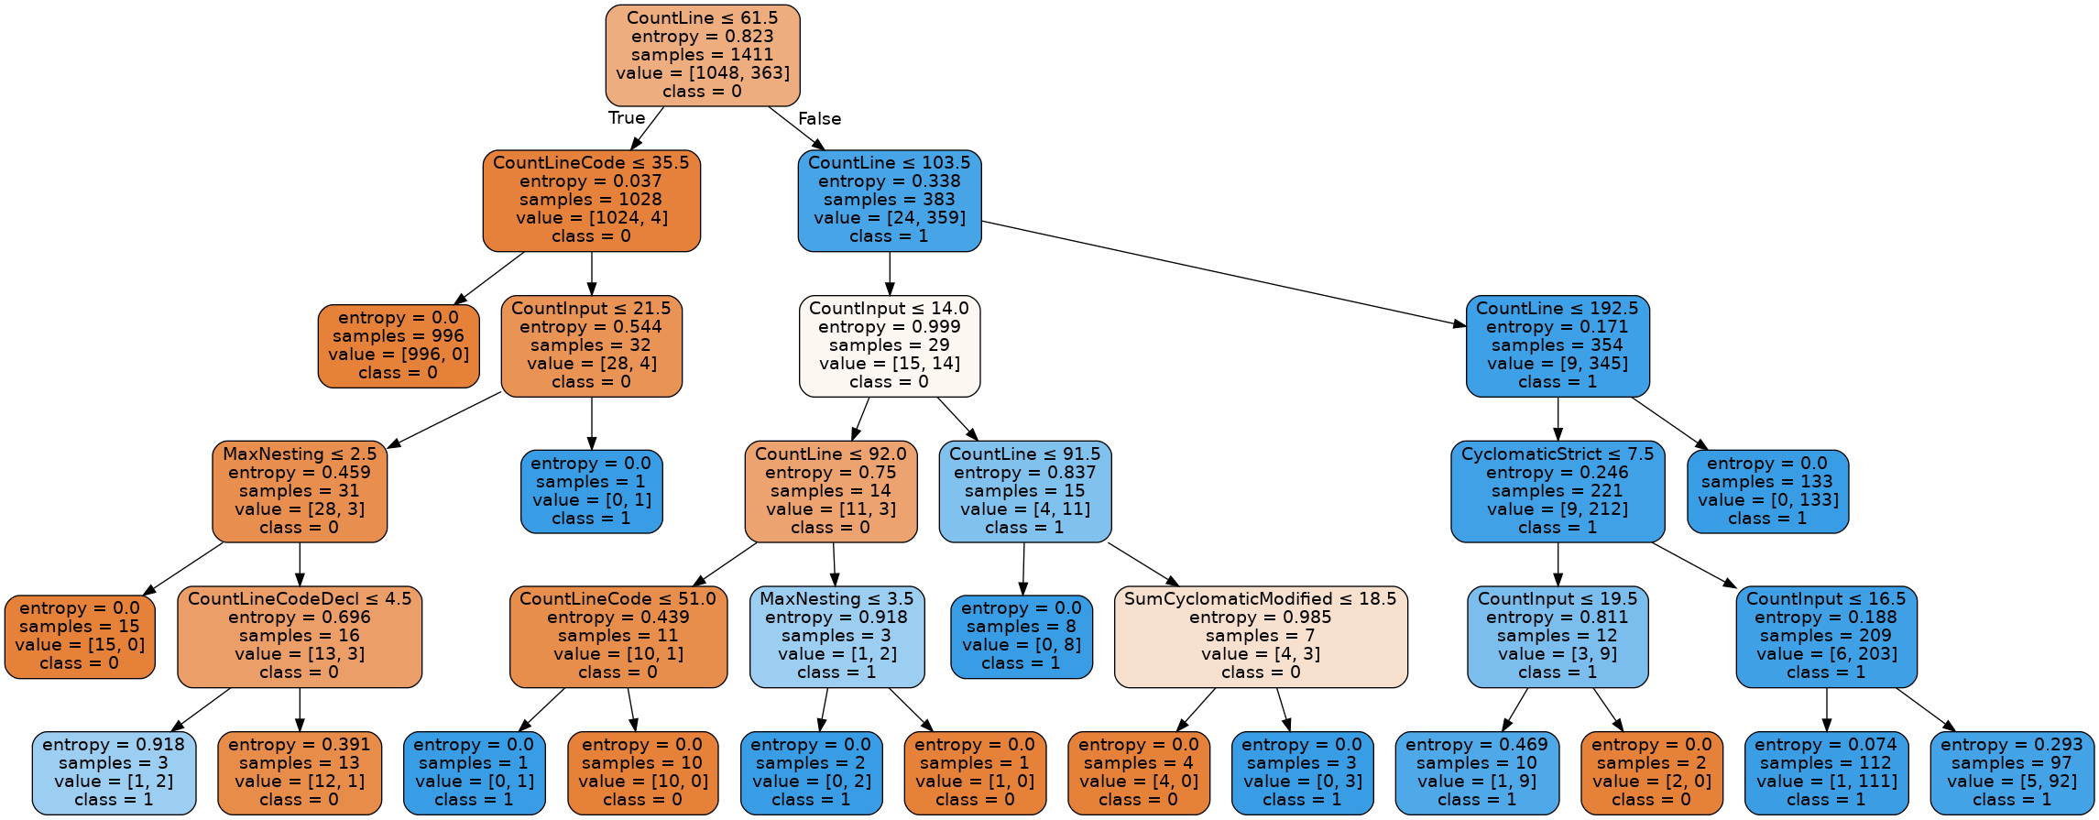
Manipulating DT models
LM visualization with feature selection

Slide 16
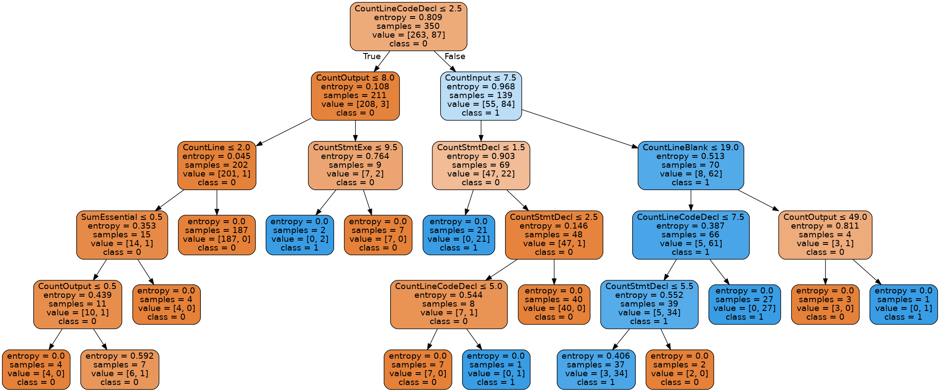
Manipulating DT models
LPL visualization

Slide 17
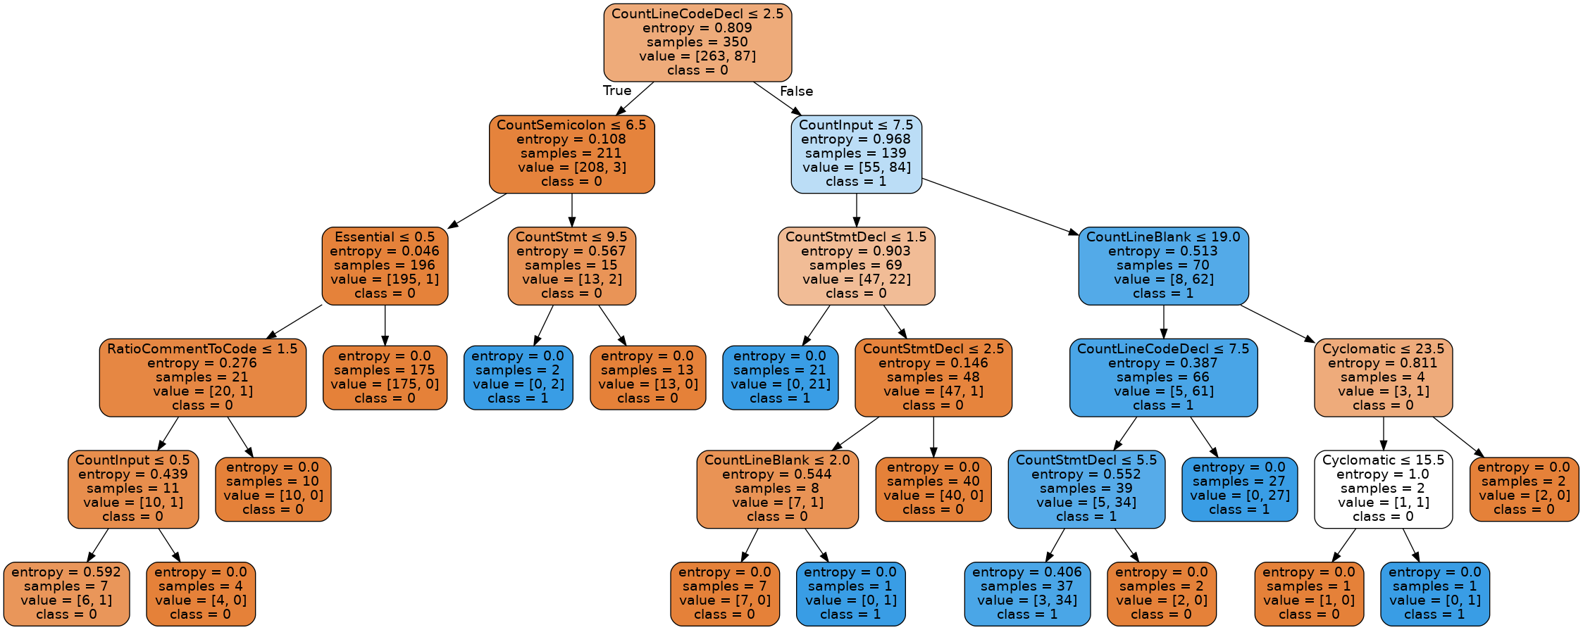
Manipulating DT models
LPL visualization with feature selection

Slide 18
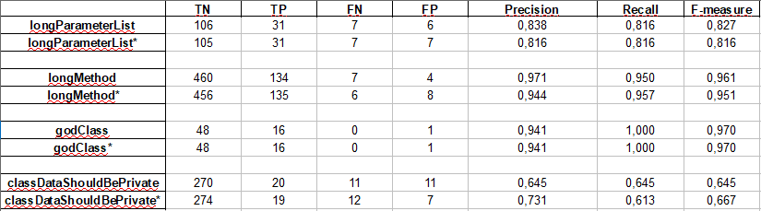
Manipulating DT models
Effectiveness Table

Slide 19
Project monitoring
Activity | Progress | What have left?
Build datasets | 80% | Low priority: pursuit originally chosen datasets Low priority: try to expand number of instances of the datasets
Manipulate and Build Models | 60% | High priority: study DT and GA to improve DT models and feature selection
Collect Code snippets | 0%
Build Questionnarie - develop django app to get data | 20%

Slide 20
Discussions

